Slide 1




A collaboratively developed platform to introduce fundamentals of IoT and IIoT
Grant Richardsª, Balamurugan Balakreshnan^{b}, Jim Bennett^{b}, Ragu Athinarayananª, Joseph Zaccaria^{c}, Peter Zink^{d}, Andrea Weatherly^{b}, Jun Yamasaki^{b}, Brittany Newellª, Gaurav Nandaª, Huachao Maoª
ªPurdue University, ^{b}Microsoft, ^{c}Rockwell Automation, ^{d}PTC

Slide 2
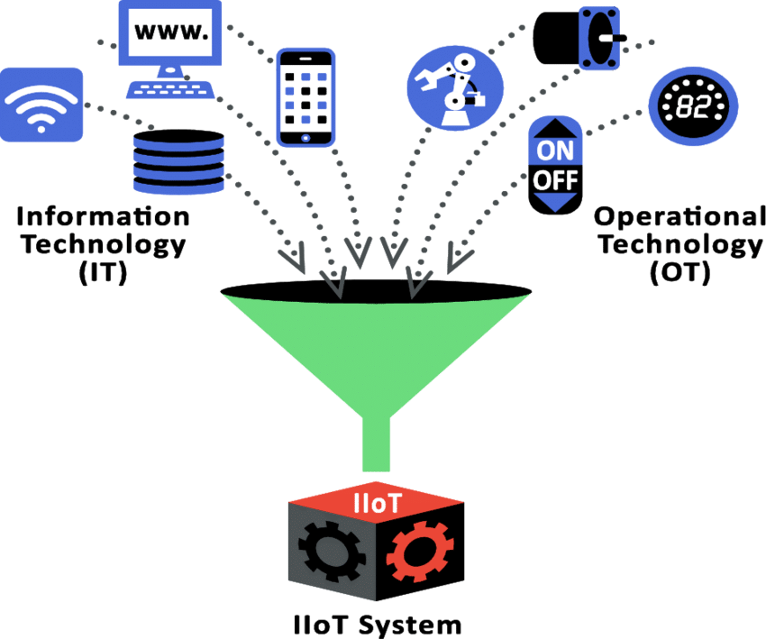
Overview
Graphic from Martin & Schrecker, et al. https://www.researchgate.net/figure/1-IT-OT-Convergence_fig3_311948248
SCALABLE INSTRUCTIONAL PLATFORM
Developed in collaboration with industry
Designed for Engineering students
Minimal prerequisite knowledge
Capable of virtualization
Develop core skills prior to engaging with live systems
Demonstrate flow of data in on-premises and cloud systems
Demonstrate concepts of cyber security
Low-cost base platform capable of expansion
Open resources - Github

Slide 3
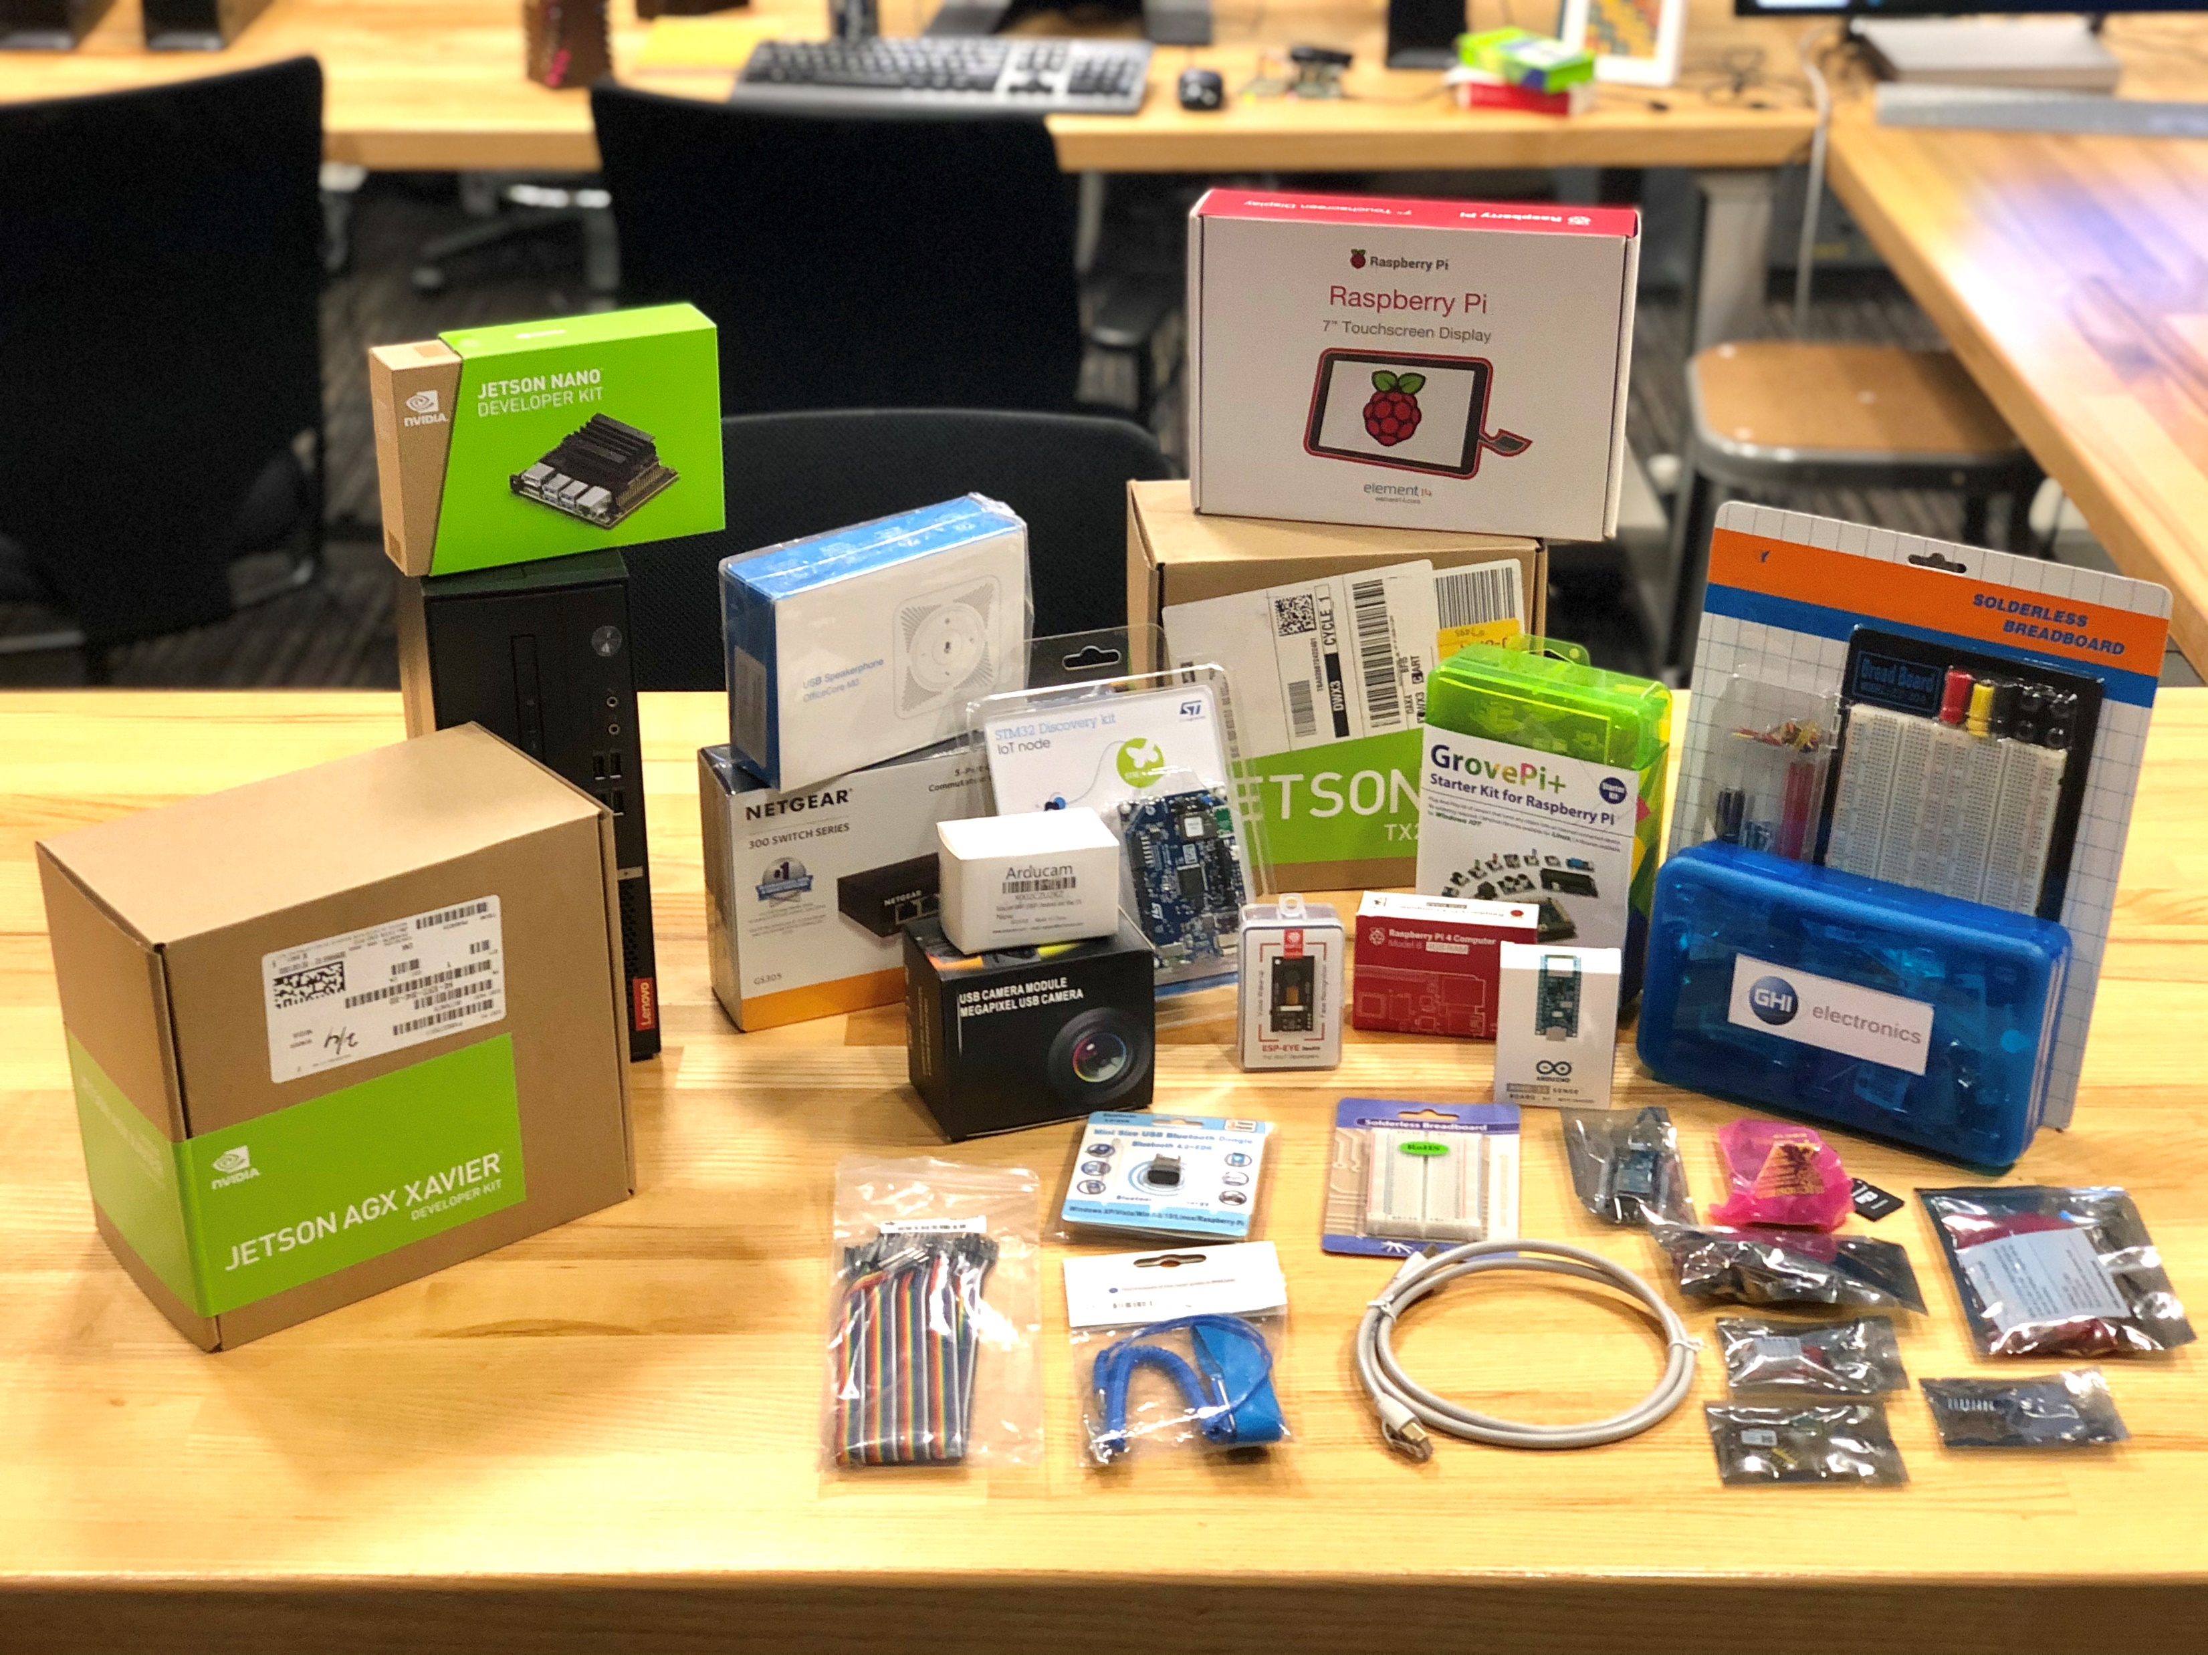
IoT Capabilities and Experiences
Introduction to IoT Systems
Enable students to get hands on real sensors and minicomputer (Raspberry Pi), AI computers (Jetson)
Build hands-on to work with industrial system
Design and crate new industrial system with IoT and AI
Work with AI minicomputer to create vision and audio-based systems
Bridge IT and OT data to enable data-driven decisions
Build predictive maintenance-based solutions for learning factory

Slide 4
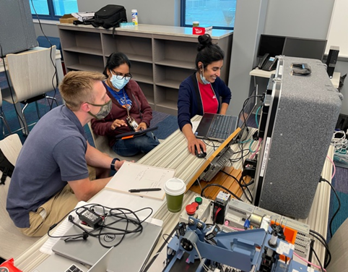
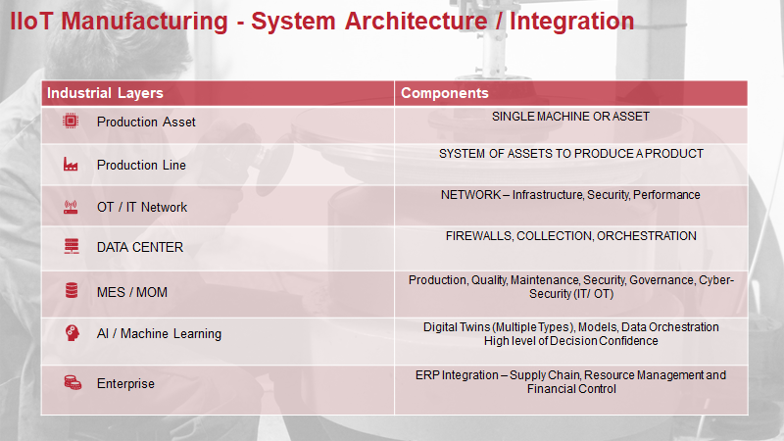
IIoT Implementation Framework
Fundamentals of IIoT Application
First Exposure to System Creation
Introduction to Business interests
IIoT in Plant Floor System Design
Introduction to Gateways
Fundamental IT/OT Networking
Measurement to Connectivity Basics

Slide 5

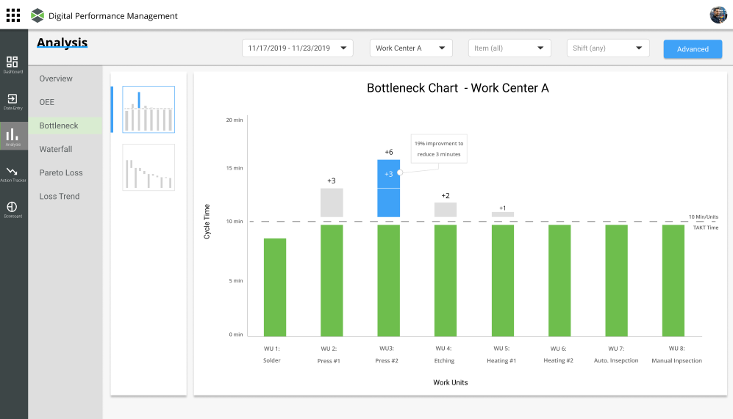


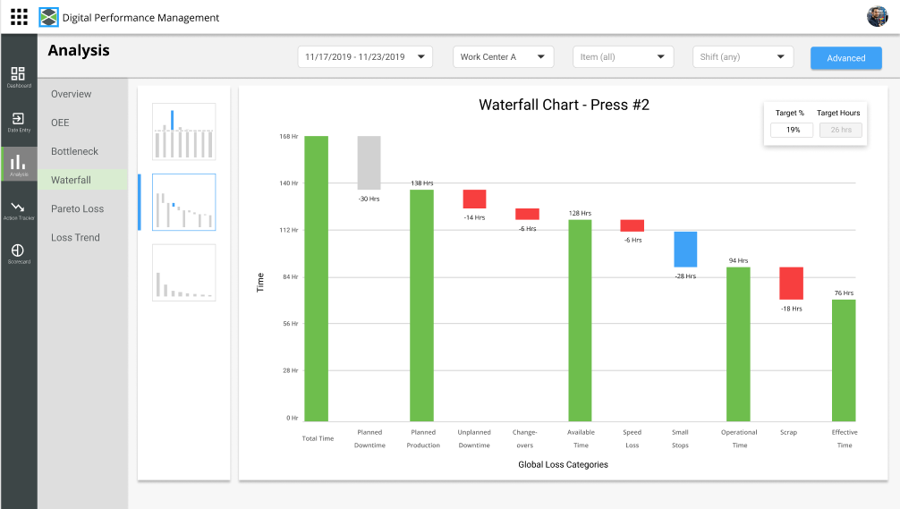
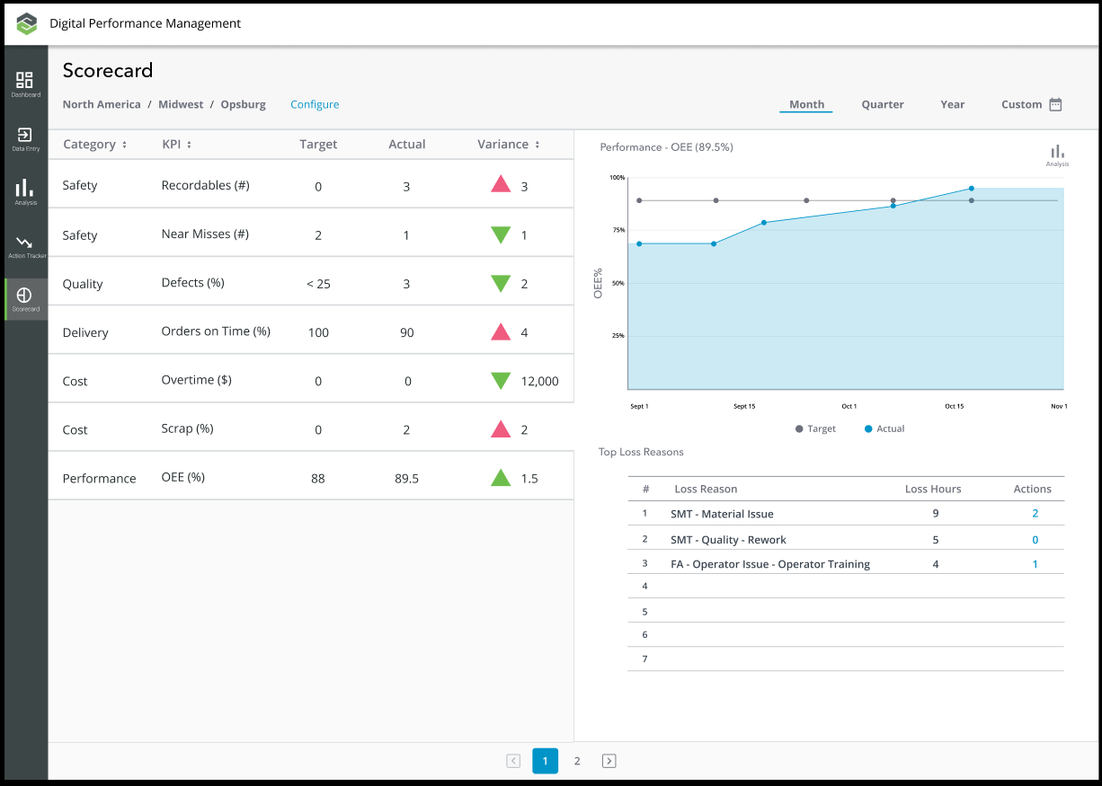
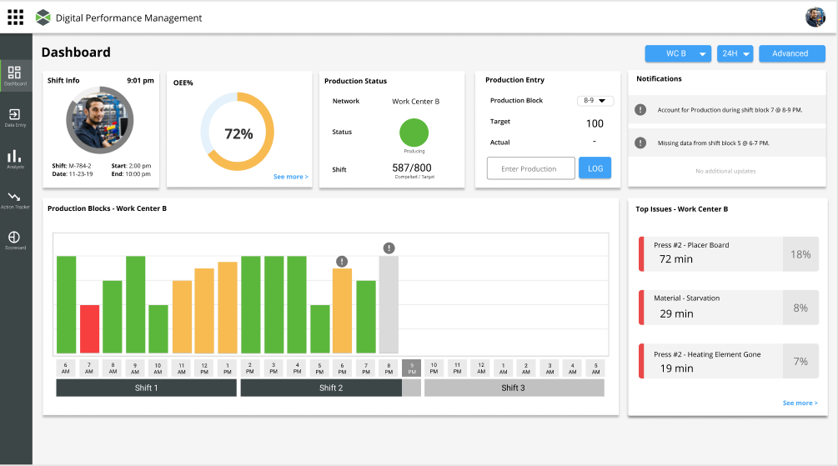


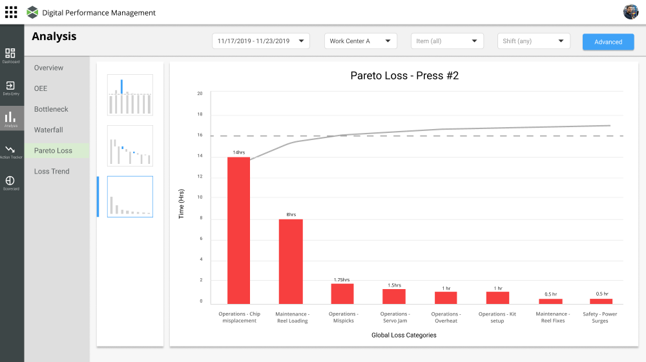
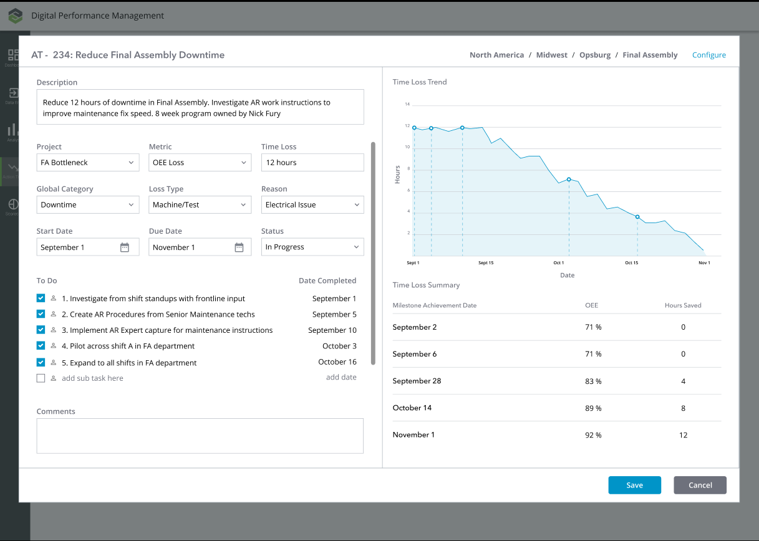
Continuous Closed Loop IIoT Problem Solving
Digital Performance Management
BOTTLENECK ANALYSIS
BOTTLENECK
Using a standardized metric, hours lost, dynamically identify where bottlenecks are to identify the highest-impact improvement opportunities in your process
TIME LOSS WATERFALL
Management
WATERFALL
1
Provide workers with a complete picture of performance, broken down by top time-loss categories
SCORECARD
PRODUCTION DASHBOARD
2
Leverage a balanced and standardized scorecard to continuously monitor and improve performance from the enterprise down to the line
Frontline
LOSS REASON PARETO
LOSS PARETO
ACTION TRACKER
Drill down into detailed loss reasons to prioritize the high impact initiatives and deliver 20%+ improvement in OEE in weeks.
ACTION TRACKER
Provide transparency and alignment on initiatives to improve operations using a data driven tracking tool that visualizes the impact of your efforts in real time
3
4

Slide 6
IoT and IIoT in Curriculum
Industrial IIoT Networks and Systems I & 2
2 courses in 2nd UG year
Connectivity, Reliability, Security
Minimal prerequisites
Programming and Circuits
First exposure to learning factory systems
Control,Data,Computational, and Safety Systems
Delivered prior to engagement with live production systems
11 additional I4.0 focused courses
Horiz/Verticallly Integrated Manufacturing Ecosystem
Four live facilities
Industrial IoT Laboratory
Smart Foundry
Intelligent Process Laboratory
Smart Learning Factory

Slide 7
Thank You!
Grant Richards, Purdue University grichard@purdue.edu
Balamurugan Balakreshnan, Microsoft babal@microsoft.com
Joseph Zaccaria, Rockwell Automation jmzaccaria@ra.rockwell.com
Peter Zink, PTC pzink@ptc.com

